Slide 1

Introduction to computer ,programing and java
University of Human Development College of Science and Technology Department of IT
Lecture :Programming
Lecturer: Tara Qadr
1st stage 2015-2016

Slide 2
Objectives
To review computer basics.
To review programs, and operating systems .
Overview history of Java
To know Java’s advantages.
To distinguish the terms API, IDE, and JDK.

Slide 3
What is computer ?
computer: is an electronic device that stores and processes data , consist of hardware and software.
Hardware: is a visible part , physical elements of the computer.
Software: provides the invisible instructions that control the hardware and make it perform specific tasks.

Slide 4
Computer Hardware
A computer consists of the following major hardware components
■ A central processing unit (CPU)
■ Memory (main memory)
■ Storage devices (such as disks and CDs)
■ Input devices (such as the mouse and keyboard)
■ Output devices (such as monitors and printers)
■ Communication devices (such as modems and network interface cards)
■ buses: data and power travel along the bus .

Slide 5
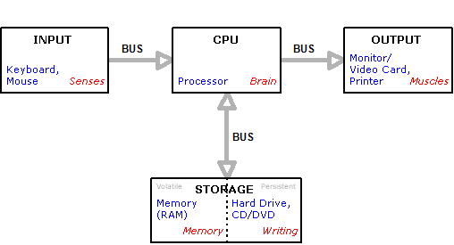
hardware components

Slide 6
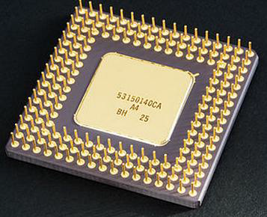
Central Processing Unit (CPU)
is the computer’s brain.
It retrieves instructions
from memory and executes them.
It’s speed is measured in megahertz (MHz),
with 1 megahertz equaling 1 million pulses per second.

Slide 7
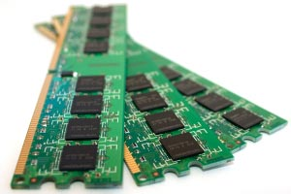
Memory
Memory is to store data and
program instructions for CPU to execute.
A memory unit is an ordered sequence of bytes
A byte holds eight bits.
A program and its data must be brought to memory before they can be executed.
The current content of a memory byte is lost whenever new information is placed in it.

Slide 8
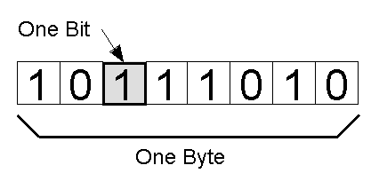
how computer store Data?
A small number such as 3 can be stored in a single byte.
One byte = 8 bits
Bit is 0 or 1
1 KB (kilobyte) = 1024 bytes
1 MB (megabyte) = 1024 · 1024 bytes
1 GB (gigabyte) = 1024 · 1024 · 1024 bytes
1 TB (terabyte) = 1024 gigabyes
1 PB (petabyte) = 1024 terabyes

Slide 9
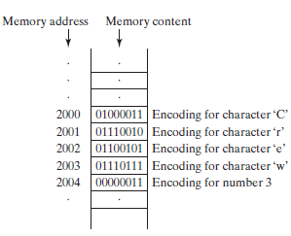
Storing data in memory
For example if we store “JAVA’ in memory each character store in single byte.
If computer needs to
store a large number that
cannot fit into a single byte,
it uses a number of adjacent
bytes.
No two data can share or
split a same byte(A byte is the
minimum storage unit).

Slide 10
Number Systems
Human‘s use decimal numbers.
Computers use binary numbers internally.
Hexadecimal numbers are often used to abbreviate binary numbers.
Binary 1 , 0
Octal 0, 1, 2, 3, 4, 5, 6, 7
Decimal 0, 1, 2, 3, 4, 5, 6, 7, 8, 9
Hexdecimal 0, 1, 2, 3, 4, 5, 6, 7, 8, 9, A, B, C, D, E, F

Slide 11
Computer Software
Software : consists of programs that instruct the hardware how to perform operations.
program is a step-by-step set of instructions.
Categories of software:
Operating systems: A collection of programs that interact directly with the computer’s hardware.
Applications: Programs designed to perform useful tasks for humans.
An operating system serves as a bridge between hardware and applications.

Slide 12
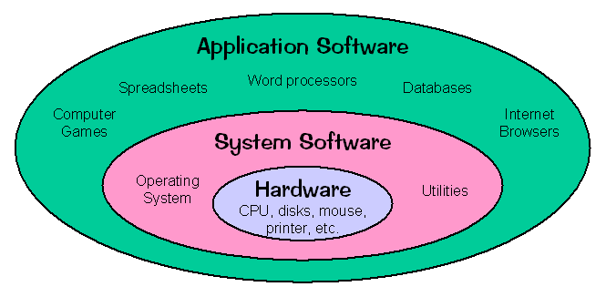
Operating Systems
The operating system(OS) is a program that manages and controls a computer’s activities.
Application programs such as an Internet browser and a word processor cannot run without an operating system.

Slide 13
Operating Systems: Examples
Desktop operating systems:
Windows 8, 7, 98, NT, XP
Linux
Mac OS
Mobile OS (used in smart phones and tablets) :
Google’s Android
BlackBerry OS
Apple’s iOS

Slide 14
Programs
Computer programs are instructions to the computer.
You tell a computer what to do through programs.
◦Without programs, a computer is an empty machine.
Programs are written using programming languages.
Computers do not understand human languages, so you need to use computer languages to communicate with them.

Slide 15
Programming Languages:
Machine Language
Assembly Language
High level Language

Slide 16
Machine Language
The fundamental language of the computer’s processor, also called Low Level Language.
All programs are converted into machine language before they can be executed.
Consists of combination of 0’s and 1’s that represent high and low electrical voltage.
Example: 1101101010011010

Slide 17
Assembly Language
Is an English-like abbreviations representing elementary computer operations.
A low level language that is similar to machine language.
Assembly languages were developed to make programming easy.
Since the computer cannot understand assembly language, however, a program called assembler is used to convert assembly language programs into machine code.
Uses symbolic operation code to represent the machine operation code.
Example: ADDF3 R1, R2, R3

Slide 18
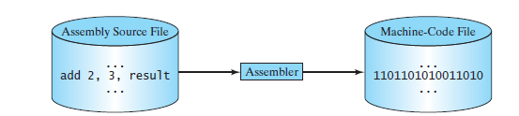
An assembler translates assembly-language instructions into machine code.

Slide 19
High Level Language
Computer (programming) languages are easier to learn.
Uses English like statements.
Examples of high level languages are: Java, C ++, Visual Basic, Pascal, Fortran, etc.
Example: the following is a high-level language statement that computes the area of a circle with radius 5:
area = 5 * 5 * 3.1415;

Slide 20
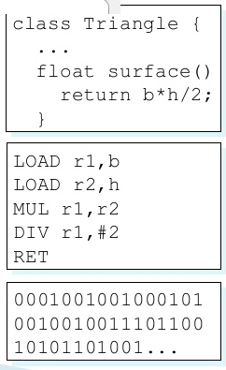
Example
High Level Language
Low-Level Language
(Assembley) Machine Language (Excutable)

Slide 21

High Level Language: Compiling Source Code
A program written in a high-level language is called a source program.
A computer cannot understand a source program.
Program called a compiler is used to translate the source program into a machine language program called an object program.
The object program is often then linked with other supporting library code before the object can be executed on the machine.

Slide 22
History of java
Sun Microsystems in1991 funded an internal corporate research project (Green Project) led by James Gosling.
Java was officially announced in May 1995.
Java’s predecessor was Oak
A key goal of Java is to write once, run anywhere
JDK Evolutions

Slide 23
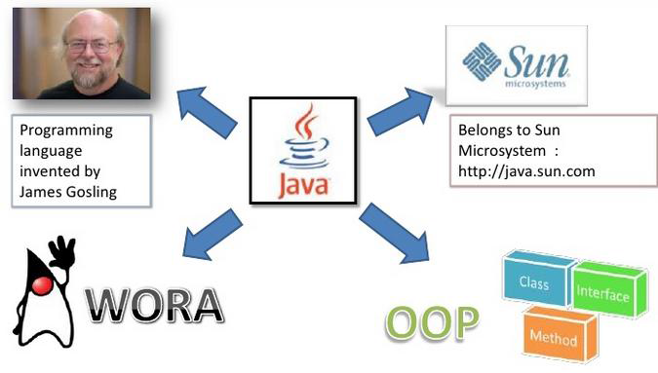
History

Slide 24
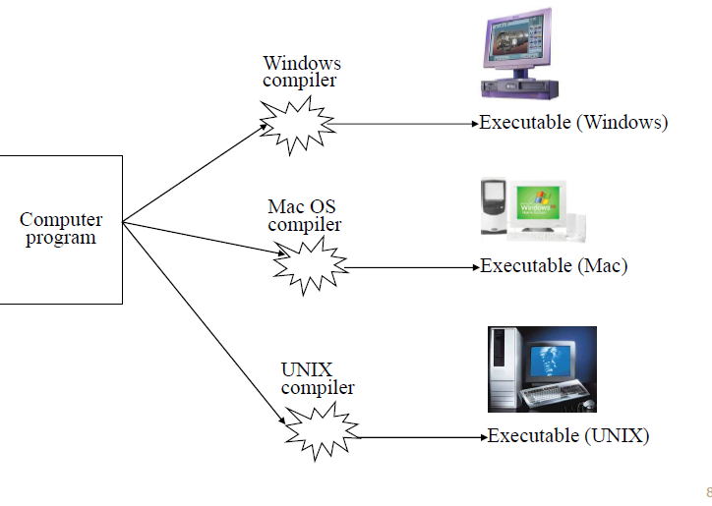
Traditional Way of Compilation Windows

Slide 25
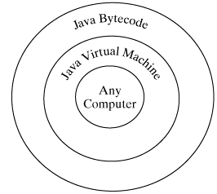
Compiling Java Source Code
Java was designed to run object programs on any platform.
Java programs (Source program) are compiled into a special type of object code, known as bytecode.
The bytecode can then run on any computer with a Java Virtual Machine.
Java Virtual Machine is a software that interprets Java bytecode.
Platform differences dealt with by JVM.

Slide 26
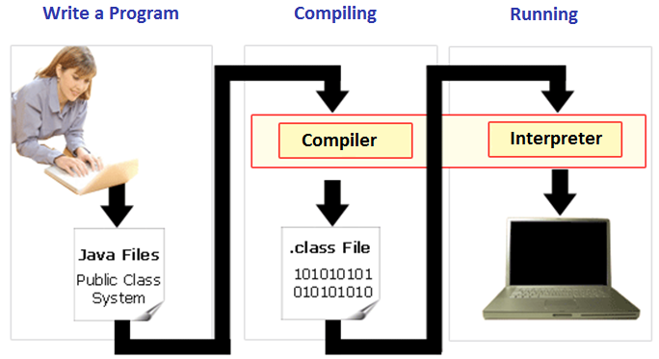
A High Level View Of Compiling/Running Java Programs
Machine language (UNIX)
Machine language (Windows)
Machine language (Apple)
(Platform/Operating specific binary10100111000001000 00100111001111001: :
class First {public static void main
(String[] args ) { } }

Slide 27
Java’s Versatility
Java is a versatile programming language, you can use it to develop applications for:
Desktop computers,
Servers
Small handheld devices.
Example: The software for Android cell phones is developed using Java.

Slide 28
Why Java?
Java is a general purpose programming language.
Java is the Internet programming language.
Many Characteristics of Java :
simple
objected-oriented
distributed
interpreted
robust
secure
architecture-neutral
portable
high-performance
multi-threaded and
dynamic

Slide 29
Java Editions
Java comes in three editions:
Java Standard Edition (Java SE)
Can be used to develop client-side standalone applications or applets.
Java Enterprise Edition (Java EE)
Can be used to develop server-side applications such as Java servlets and Java Server Pages.
Java Micro Edition (Java ME)
Can be used to develop applications for mobile devices such as cell phones.

Slide 30
Java Development Kit (JDK) Versions
JDK 1.0 (January 23, 1996)
JDK 1.1 (February 19, 1997)
J2SE 1.2 (December 8, 1998)
J2SE 1.3 (May 8, 2000)
J2SE 1.4 (February 6, 2002)
J2EE 5.0 (September 30, 2004)
Java SE 6 (December 11, 2006)
Java SE 7 (July 28, 2011)
Java SE 8 (March 18, 2014)

Slide 31
The Java APIs
An Application Program Interface (API) is a set of commands, functions, and protocols which programmers can use when building software.
It allows programmers to use predefined functions, instead of writing them from scratch.

Slide 32
Java IDE Tools
Borland JBuilder
NetBeans Open Source by Sun
Eclipse Open Source by IBM
Other tools:
TextPad Editor
JCreator LE
JGrasp
BlueJ
DrJava

Slide 33
Reference
INTRODUCTION TO JAVA PROGRAMMING COMPREHENSIVE VERSION 10th Edition
Deitel , “Java How to Program”, 9thed.
THANK YOU

